Slide 1




FTR.
Home
About me
Achievement
Contact
MIDTERMS
CASCADING STYLE SHEET

Slide 2

FTR.
USING HTML ONLY
05

Slide 3
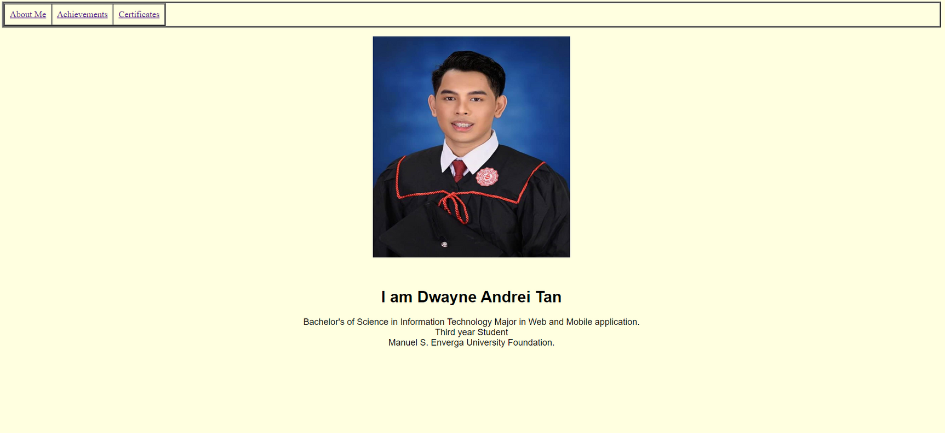
Homepage Before

Slide 4
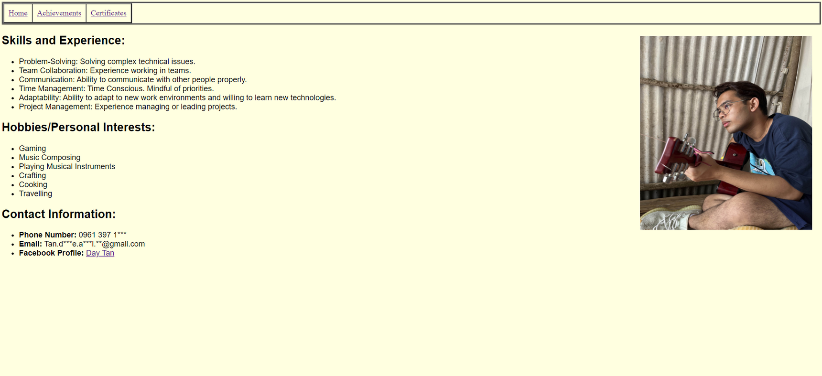
About Me Before

Slide 5
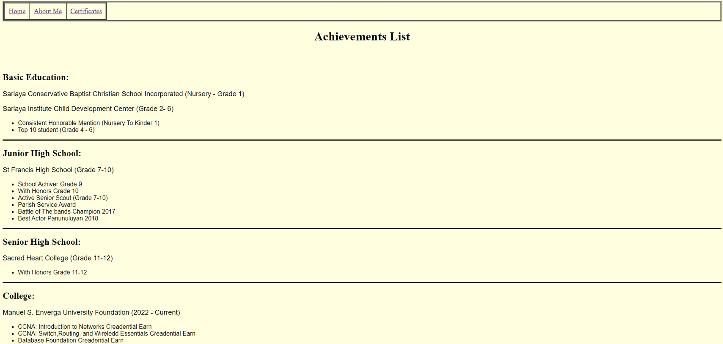
Achievement Before

Slide 6
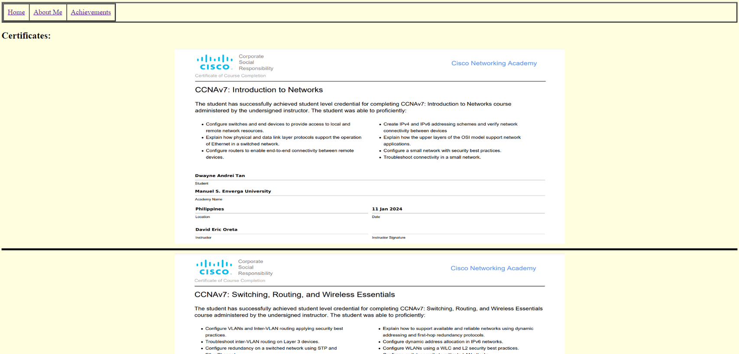
Certificates Before

Slide 7
FTR.
USING HTML AND CSS
05

Slide 8
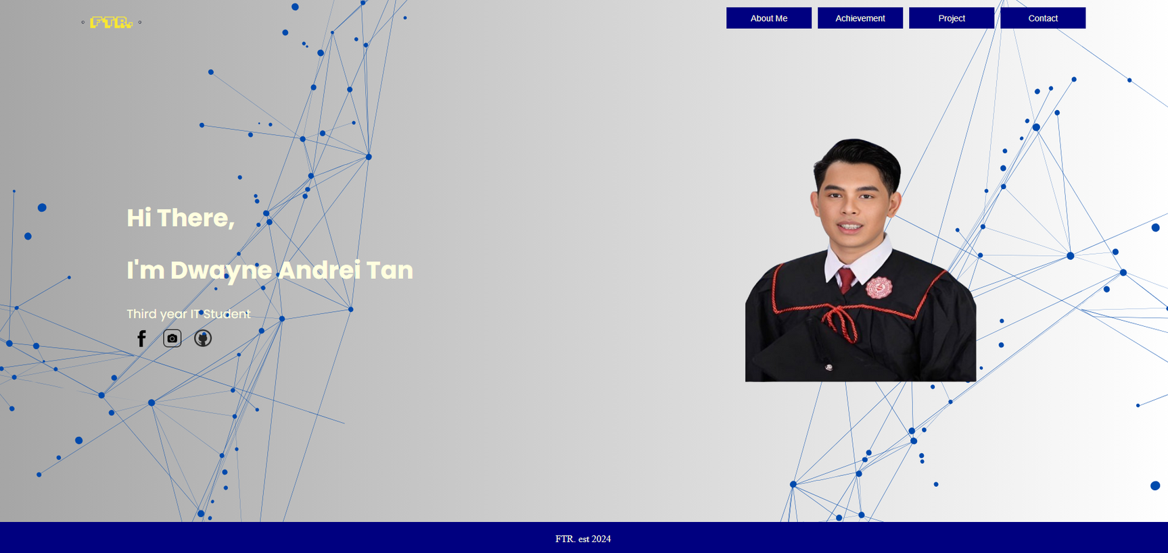
Homepage After

Slide 9
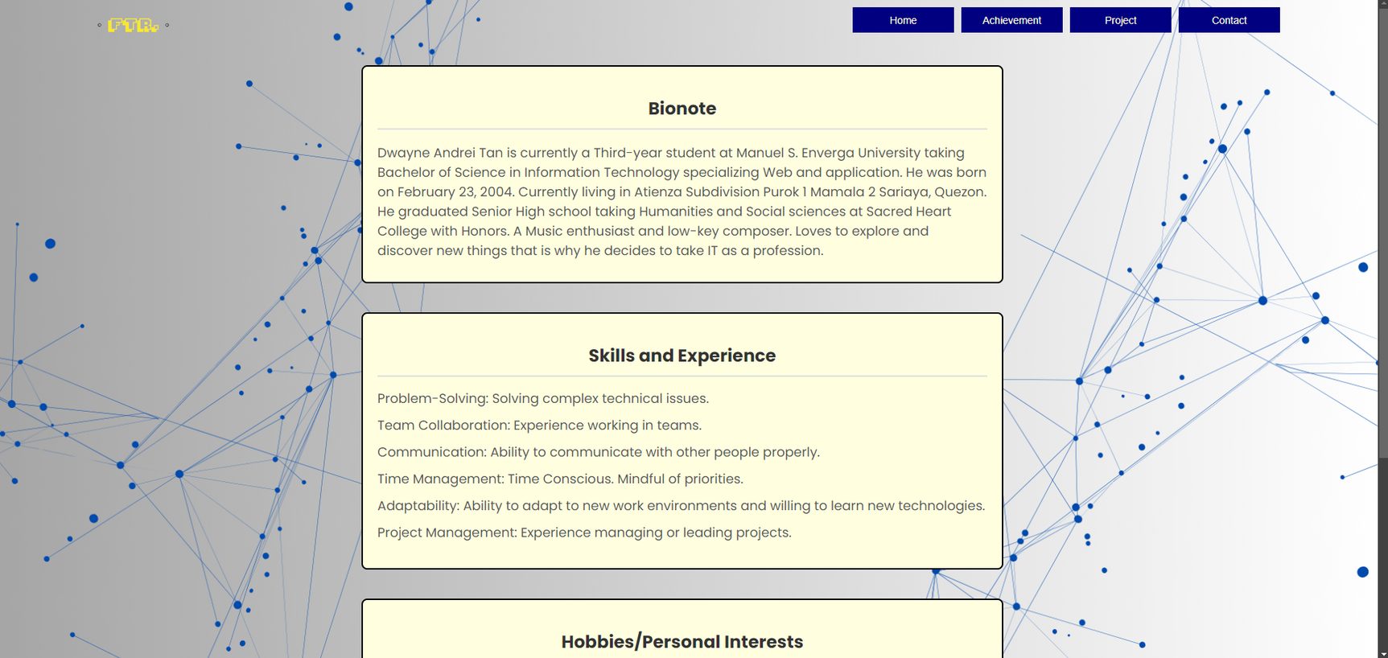
About Me After

Slide 10
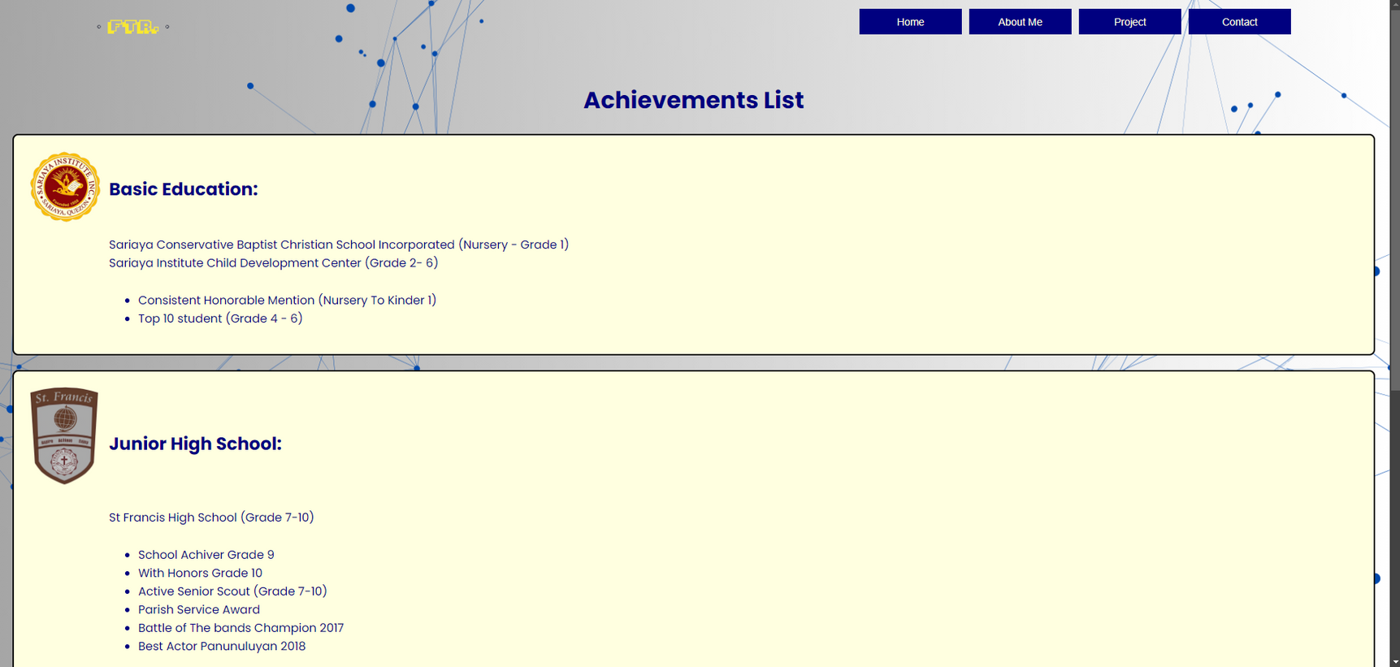
Achievement List After

Slide 11

Project Page (new)

Slide 12

Contact page After

Slide 13
FTR.
Home
About me
Achievement
Contact
THANK YOU

